Slide 1
SMART ELEVATOR SYSTEM USING ARDUINO PROGRAMMING Review-1

Slide 2
Abstract
This Smart Elevator System tries to overcome the problem of getting late to an important meeting or an exam because the elevator was not available or else it kept on stopping at each floor. We solve this exact problem with the help of a few IOT sensors. At the hardware level, this system will involve an ultrasonic sensor, motion detector, electric peak load cell sensor and it will use Arduino IDE as the software. Utilizing the data collected from these sensors will result in reduction in unwanted stoppage of elevators. Implementing this system in the elevators everywhere will not only save the users’ time but it will also cut down on the power usage of elevators. It will help in reducing the frequent maintenance charges of the elevators caused due to excessive load on a particular elevator as well.

Slide 3
Problem Statement
Internet of Things (IoT) technological advancements over the past ten years have significantly altered the elevator sector. IoT can be used to enable proactive, condition-based analysis, and predictive maintenance in any form of elevator solution. Smart elevators enable remote control and monitoring of the elevator due to its ability to monitor performance, make maintenance decisions in real-time, provide updated status, and more. Different types of connectivity are used to control or monitor a smart elevator.

Slide 4
Objective
Elevator communicates with the elevator controller via the GPIO pin or UART and internally connects with the custom hardware via a Wi-Fi or LAN interface. When hardware changes the value of a GPIO pin or register, it notifies the IoT central and sends signals. The hardware will recognize whenever the elevator controller modifies the signal, at which point it will send the signal to the IoT central. In order to build a meaningful signal, predict faults, identify faults, and send that signal to the user interface using a WebSocket, IoT Central will export the data to the logic application layer and take it down to the primary logic. The next IoT Elevator is outperforming older models in terms of efficiency. We used to manually perform maintenance tests, monitor records and status, and inspect elevators. That required too much time and money.

Slide 5
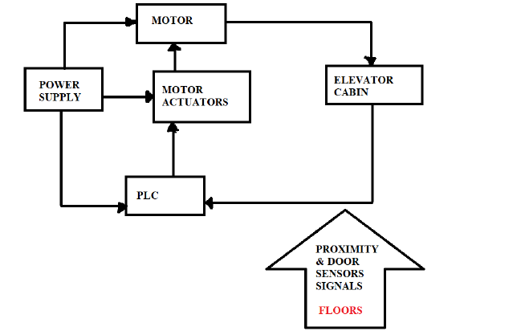
PROPOSED ALTERNATIVE METHODOLOGY AND DESIGN
At hardware level this system will involve an ultrasonic sensor, motion detector, Electro Peak loadcell sensor and it will use Arduino IDE as the software. We propose a smart elevator system that would save people a great deal of time by improving the efficiency of the system. The system involves a motion detector and an ultrasonic sensor which will detect whether someone is near the lift when the buttons are pressed. If no one is found then, the lift will not stop at that floor. In addition, a weight sensor is used to determine if the lift is overweight or not. Overloaded lifts will not move to the next floor until the extra load is removed.

Slide 6
REFERENCES (AS PER IEEE FORMAT)
1. L. -D. Van, Y. -B. Lin, T. -H. Wu and Y. -C. Lin, "An Intelligent Elevator Development and Management System," in IEEE Systems Journal, vol. 14, no. 2, pp. 3015-3026, June 2020.
2. G. Hangli, T. Hamada, T. Sumitomo and N. Koshizuka, "Intelevator: An Intelligent Elevator System Proactive in Traffic Control for Time-Efficiency Improvement," in IEEE Access, vol. 8, pp. 35535-35545, 2020.
3. H. I. Abbasi and A. J. Siddiqui, "Implementation of smart elevator system based on wireless multi-hop AdHoc sensor networks," 2011 IEEE 2nd International Conference on Networked Embedded Systems for Enterprise Applications, 2011, pp. 1-7.
4. Ahn, Sungyong, Lee, Soyoon, and Bahn, Hyokyung. ‘A Smart Elevator Scheduler That Considers Dynamic Changes of Energy Cost and User Traffic’. 1 Jan. 2017 : 187 – 202.
5. S. Yue and R. K. Smith, "Applying Context State Machines to Smart Elevators: Design, Implementation and Evaluation," 2021 IEEE Symposium Series on Computational Intelligence (SSCI), 2021, pp. 1-9.
6. I. Skog, I. Karagiannis, A. B. Bergsten, J. Härdén, L. Gustafsson and P. Händel, "A Smart Sensor Node for the Internet-of-Elevators—Non-Invasive Condition and Fault Monitoring," in IEEE Sensors Journal, vol. 17, no. 16, pp. 5198-5208, 15 Aug.15, 2017.

Slide 7
REFERENCES (AS PER IEEE FORMAT)
7. S. Le et al., "Smart Elevator Control System Based on Human Hand Gesture Recognition," 2020 IEEE 6th International Conference on Computer and Communications (ICCC), 2020, pp. 1378-1385.
8. H. I. Abbasi and A. J. Siddiqui, "Implementation of smart elevator system based on wireless multi-hop AdHoc sensor networks," 2011 IEEE 2nd International Conference on Networked Embedded Systems for Enterprise Applications, 2011, pp.1-7, doi: 10.1109/NESEA.2011.6144930.
9. S. Khan and K. Ullah, "Smart elevator system for hazard notification," 2017 International Conference on Innovations in Electrical Engineering and Computational Technologies (ICIEECT), 2017, pp. 1-4, doi:10.1109/ICIEECT.2017.7916564.
10. D. T. Bamunuarachchi and D. N. Ranasinghe, "Elevator group optimization in a smart building," 2015 IEEE 10th International Conference on Industrial and Information Systems (ICIIS), 2015, pp. 71-76, doi: 10.1109/ICIINFS.2015.7398988.
11. Shafique Ahmed Soomro, Syed Abid Ali Shah Bukhari, Muhammad Faizan khan, Asad Ali, Muhammad Faisal Shaikh, Mohsin Ali Koondhar, Irfan Ali Channa, September 2020.
12. Rajendra B. Sadafale Professor, Department of Electrical Engineering, Aniket S. Hissal, Rahul V. Joshi, Rohit M. Bachchhe.
13. The paper titled ‗A Survey Paper on Design & Control of an Elevator for Smart City Application‘by Prof. Omkar M. Shete.
14. Paper titled A Survey of Elevator Group Control Systems for Vertical Transportation: A Look at Recent Literature‘ by Joaquin R. Fernandez, Pablo Cortés.
15. Smart Elevator by Ms. Kavita Jadhav, Mr. Piyush Dhamne, Ms. Prachi Matsagar, Ms. Sujata Suryavanshi.

Slide 8
Thank You

